Slide 1
OPERATING SYSTEM
DFC 2043 by : Zarina Binti Musa
GROUP MEMBERS:
Neeroshan A/L Kamala Nathan 13DIP15F1132
Nur Hazliana Binti A Nizam 13DIP15F1065
Intan Sufina Binti Abdul Hadi 13DIP15F1201
Thaneeswary A/P Pacrisamy 13DIP15F1101
Nurin Jaslina Binti Miskam 13DIP15F1017

Slide 2
MULTITASKING
The ability to execute more than one task at the same time, a task being a program in multitasking, only one CPU is involved, but it switches from one program to another so quickly that it gives the appearance of executing all of the programs at the same time.
There are two basic types of multitasking:
    Preemptive – the operating systems parcel out CPU time slices to each program.
    - e.g:Windows 95, Windows NT, Amiga Operating system
    and UNIX.
    Cooperative – each program can control the CPU for as long as it needs it.If a program is not using the CPU, however, it can allow another program to use it temporarily.
          - e.g:-Microsoft Windows 3.x and the Multifolder(for Macintosh computers)

Slide 3
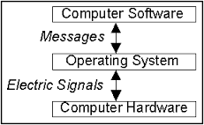
MULTITASKING
Example of multiprogramming, we open the world, excel, access and each other application together but while we type in word other applications such as excel and access are just present in main memory but they are not performing any task or work

Slide 4
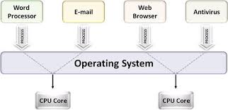

EXAMPLE OF MULTITASKING

Slide 5
MULTIPROGRAMMING
Multiprogramming is the technique of running several programs at a time using timesharing.
It allows a computer to do several things at the same time.
Multiprogramming creates logical parallelism.
The concept of multiprogramming is that the operating system keeps several jobs in memory simultaneously.
The operating system selects a job from the job pool and starts executing a job, when that job needs to wait for any o/o operations the CPU is switched to another job.

Slide 6
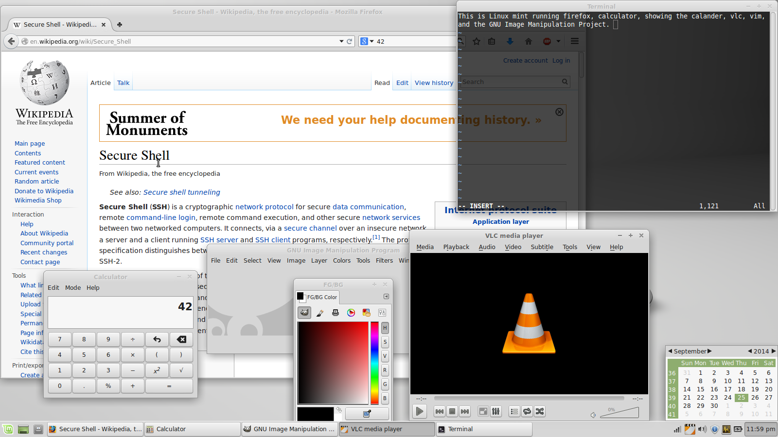
MULTIPROGRAMMING
Example of multiprogramming we listen to music and do internet browsing at the same time (they execute parallely)

Slide 7
TIME-SHARING
The use of a computer system by more than one individual at the same time.
Time-sharing runs separate programs concurrently by interleaving portions of processing time allotted to each program(user).

Slide 8
BUFFERING
A temporary storage area, usually in RAM.
Store data in memory while transferring between devices
The purpose of most buffers is to act as a holding area , enabling area the CPU to manipulate data before transferring it to a device.
Because the processes of reading and writing data to a disc are relatively slow, many programs keep track of data changes in a buffer and then copy the buffer to a disk.
For example, word processors employ a buffer to keep track of changes to files, then when you save the file, the word processor update the disk file with the contents of the buffer. This is much more efficient than accessing the file on the disk each time you make a change to the file.

Slide 9
SPOOLING
Spool stands for “simultaneous peripheral operation online”.
A spool is a buffer that holds output for a device, such as a printer that cannot accept interleaved data sreatms.
Spooling refers to a process of transferring data by placing it in a temporary working area where another program may access it for processing at a later point in time.
Although a printer can serve only one job at a time, several applications may wish to print their output concurrently, without having their output mixed together.

Slide 10
SPOOLING
The operating system solves this problem by intercepting all output to the printer .
The spooling system copies the queued spool files to the printer one at a time. Without a spooler, the OS would allow data to pass to the printer and the application program would wait for completiton before continuing.
Each application’s output is spooled to a separate disk files.
    When an application finishes printing, the spooling system queues spool files to the printer.

Slide 11
CACHING
Pronounced cash, a special high-speed storage mechanism. Cache can be either a reserved section of main memory or an independent high-speed storage device. Two types of caching are commonly used in personal computers: memory caching and disk caching.
MEMORY CACHING
A memory cache, sometimes called a cache store or RAM cache, is a portion of memory made of high speed static RAM (SRAM) used for main memory. Memory caching is effective because most programs access the same data.
DISK CACHING
Disk caching works under the same principle as memory caching, but instead of using high speed SRAM, a disk cache uses conventional main memory. The most recently accesed data from disk is stored in a memory buffer.Disk caching can dramatically improve the perfomance of applications.

Slide 12
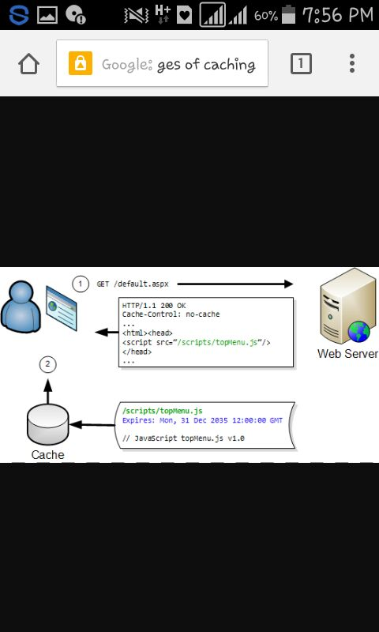
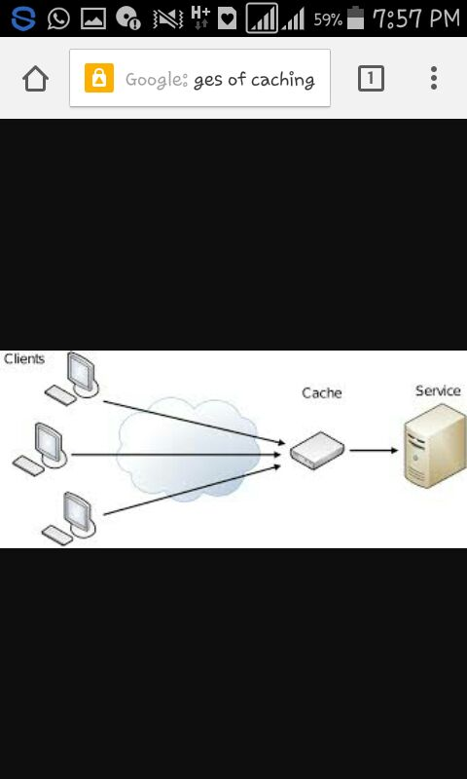
CACHING

